Slide 1
Servlets
Servlet Context and Config
LEVEL – PRACTITIONER

Slide 2
About the Author
Created By: | Renjith(t-renjith)/Shanmu (105110)
Credential Information: | Trainer/ Sr Architect
Version and Date: | 1.0, April 15’td 2011
Cognizant Certified Official Curriculum
Notes:
For tde animators:
tdis screen content needs to be rendered in tde flash, no animations needed.

Slide 3









Icons Used
Hands on Exercise
Questions
Tools
Coding Standards
Test Your Understanding
Case Study
Best Practices & Industry Standards
Demonstration
Workshop

Slide 4
Objectives
After completing this chapter you will be able to understand:
What is Servlet Configuration?
How to set initial Parameters for a Servlet?
What is Servlet Context?
How to set Initial values in context parameter?
How to set context level attributes?

Slide 5
Servlet Config
Servlet container is a object used for holding the configuration details of the servlets in a web application.
Configuration Example : Initialization Parameters, Servlet Name.
How Servlet Config is loaded?
Step 1: When a request to a servlet comes the web container will initialize the servlet.
Step 2: The web container will parse the web.xml file and read the configurations of the servlet to be initialized.
Step 3: The web container then will create a servlet config object and load the configuration details of the servlet in the object.

Slide 6
Some more details about Servlet Config
A single instance of ServletConfig is created for each Servlet.
Example: EmployeeServlet and TaxServlet will have their own Servlet config objects.
The ServletConfig is an interface with methods defined in the JEE specifications.
All Web containers such as Tomcat, Jrun need to provide implementations for the specifications defined in the ServletConfig interface.
The implementation of ServletConfig will be different for different web containers.

Slide 7
Important Methods in ServletConfig Interface
Method | Description
String getInitParameter(String parameterName) | Returns a String, the value of the named initialization parameter or null if the parameter does not exist.
Enumeration getParameterNames() | Returns the initialization parameters names as an Enumeration of String objects or an empty Enumeration if the servlet has no initialization parameters.
ServletContext getServletContext() | Returns a reference to the ServletContext.
String getServletName() | Returns the name of the Servlet.

Slide 8

How to use ServletConfig?
ServletConfig object is passed as an argument to the init() method of the servlet by the web container during servlet initialization.
Hence to use the Servletconfig we need to override the init(ServletConfig config) method.
During Servlet initialization, container passes the config object as an argument to the init method.

Slide 9
What are Servlet initialization parameters?
Initialization parameters are used by developers to set some parameter values for the servlet to use. This will be stored as key/value pairs.
Example: Assume in a application there is a rule that by default the employee citizenship is Indian. In EmployeeServlet the developer can set a initialization parameter as
“Citizenship = Indian” where the “Citizenship” is the key and “Indian” is the value.
These parameters can be configured in web.xml.
These initial parameters will be loaded to the ServletConfig object during the servlet initialization phase.

Slide 10
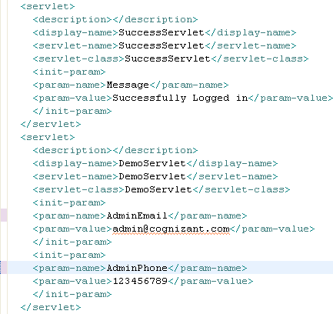
Setting init parameter in web.xml
Init parameters are declared inside <init-param> tag .
The parameter name is declared inside <param-name> and value inside <param-value> respectively.
Note :
Init-parameter is declared separately for each servlet
Each init parameter needs to be declared inside a separate <init-param> tag.

Slide 11
How to read Initialization parameter?
Init parameters can be read using the getInitParameter() method of ServletConfig object.
Syntax :
String variable=config.getInitParameter( String parameterName)
Where, config is the servletConfig Object and parameterName is the key name of the parameter set in web.xml.
Example : This retrieves the admin’s email and phone number configured.
String adminEmail=config.getInitParameter(“AdminEmail”);
String adminPhone=config.getInitParameter(“AdminPhone”);
Note : In case you don’t know the parameter name, the parameter names can be retrieved as an enumeration using the getInitParameterNames() method. By iterating the enumeration, the value for each parameter name can be obtained by the getInitParameter() method.

Slide 12
Lend a Hand – Initialization Parameter
This is a demo for associates to learn how to configure and read initialization parameters.
Step 1 : Create a dynamic web project named “ServletsDemo”.
Step 2: Create a Servlet named “ConfigDemo”.
During the servlet creation add the following value as the init parameter(refer to the screen shot in next slide)
Parameter-name : adminEmail
Parameter-value :admin@cognizant.com
Step 3 : Read the values using ConfigDemo Servlet and print it.

Slide 13
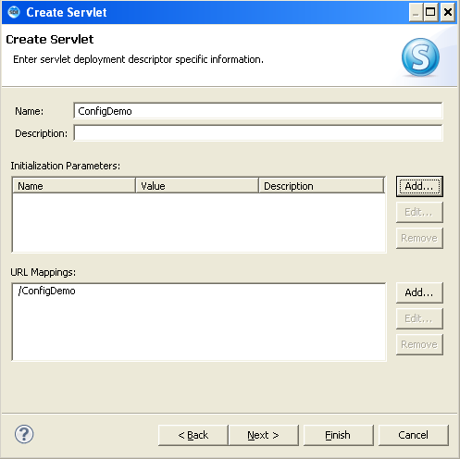
Lend a Hand – Step 2: Adding Init parameter
When creating the servlet add the admin email initialization parameter.

Slide 14
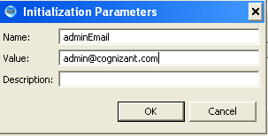
Lend a Hand - Step 2: Adding init parameter(cont)
A box as shown below will appear.
Enter name as “adminEmail” value as “admin@cognizant.com”
Click “add “ to add more parameters.

Slide 15
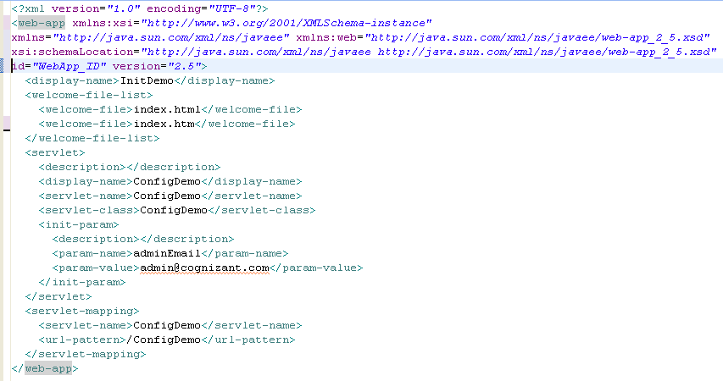
Lend a Hand – Web.xml
The init parameter can be seen configured in the web.xml file

Slide 16
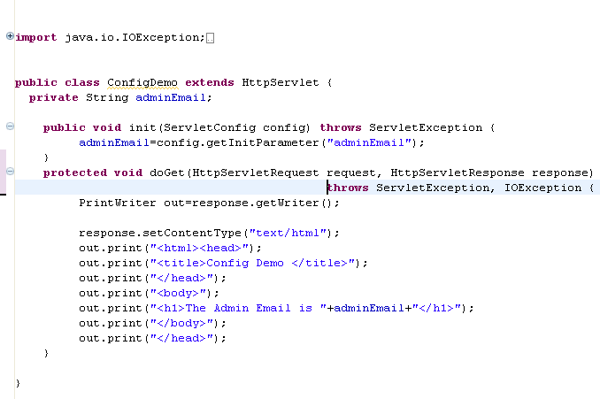
Lend a Hand – Step 3: servlet Code
Override the init method and implement the servlet as shown below.
ServletConfig object passed by the container
Reads the parameter value

Slide 17
Deploy and Run
Step 1 : Deploy the application
Step 2 : Call ConfigDemo servlet from the browser
http://localhost:8005/InitDemo/ConfigDemo

Slide 18
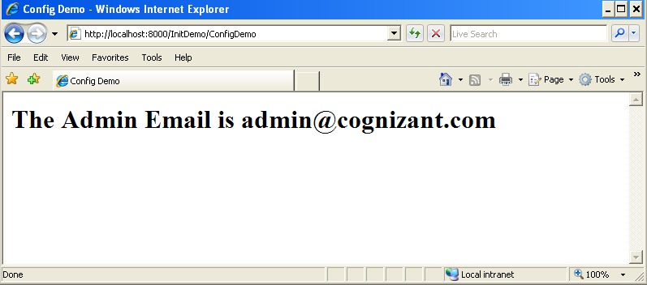
Lend a Hand – Screen shot

Slide 19
Hands on Exercise
Develop the following servlet by configuring init parameters.
Create a servlet “DatabaseServlet” with following init parameters
databaseURL :
databaseUserName
databasePassword
masterTableName
2. Read the init parameters and print the values in browser as name-value pair in the following format.
Database URL | jdbc:mysql://localhost/mydb
Database User Name | root
Password | root
Master Table | Student_Master

Slide 20

A Problem statement
Tim was developing an application where he has multiple pages with a state dropdown. The states are being maintained in database. Tim has developed the application in such a way that he queries the states from database every time he loads the JSP. Ron a developer recommended a solution for Tim.
Tim used the solution and he was amazed to see how fast the application responded.
Guess how Tim would have achieved it?
He used Servlet Context.
20

Slide 21
What is a Servlet Context?
Servlet context refers to the context in which the servlet runs.
It is a gateway between the web container and the servlets.
There will be only one instance of servlet context per web application shared by all the servlets in the application.
Used for storing values which can be shared across all the servlets in the web application.
21

Slide 22


How Servlet Context works?
Web container
Client requests payroll servlet
Get states
Servlet
Context
Payroll Servlet
Payroll servlet responds back.
List of states
Request
Employee
Servlet
Client
Browser
Get states
Employee servlet responds back.
In the above example the states stored in the servlet context is consumed by both payroll and employee servlet.
One instance of Servlet context are shared among the servlets.

Slide 23
Where is Servlet Context used?
In development projects servlet context are used in the following instances,
To store master data values which is used by presentation tier (JSP), example: states, country, Account status etc.
To store menu links which is used across many JSP/servlets in a application.
To store any other data which needs to be shared across the JSP and servlets developed in a web application.
23

Slide 24
More on Servlet Context
The container creates the servlet context object and there will be only one context object available per web application.
Context level init parameters can be set which can be reused by all the servlets in the context
A servlet can set values to the context as attributes which can be consumed by other servlets.

Slide 25
ServletContext Interface
This interface contains the methods for accessing the ServletContext created by the web container. Similar to ServletConfig the web container should implement the methods of this interface.
Method | Description
Object getAttribute(String attributeName) | Returns the value set with the given attribute name.
Enumeration getAttributeNames() | Returns an Enumeration containing the attribute names available within this servlet context.
void setAttribute(String attributeName,Object value) | Binds an object to a given attribute name in this servlet context.
Void removeAttribute(String attributeName) | Removes the attribute with the given name from the servlet context.

Slide 26
Important Methods in ServletContext (cont)
Method | Description
String getInitParameter(String parameterName) | Returns a String containing the value of the named context-wide initialization parameter, or null if the parameter does not exist.
Enumeration getParameterNames() | Returns the names of the context's initialization parameters as an Enumeration of String objects
String getRealPath(String path) | Returns a String containing the real path for a given virtual path.
Context Parameter Vs Attribute
Context Parameter are values which is set in the web.xml and can be loaded during the application deployment.
Context attribute are value which are dynamically set by the application (say servlet) for sharing it across the application.

Slide 27


Managing servlet Context
The servlet context handle is obtained using the getServletContext method of servlet config.
ServletContext context = config.getServletContext();
Note :
Since ServletConfig object is available only inside the init() method the context object needs to be read inside init() so declare ServletContext context as a class variable to make it available across other methods in servlet.
Another option is preserving the config object by declaring a class level ServletConfig variable and inside init() assigning the config object to the newly declared variable.
Context object preserved by assigning to instance variable
Config object preserved by assigning to class variable

Slide 28

Setting Context Level Parameter
Context parameters for an application can be declared by setting in the deployment descriptor.
Parameter Declaration
Parameter Name
Parameter Value
NOTE: Context parameters are declared outside all the servlet declaration since they are common to the entire application.

Slide 29
Reading Context parameters.
Context parameters can be read using getInitParameter() method of the ServletContext interface.
Syntax :
String variable=context.getInitParameter(String paramName);
Where, paramName is the key with which the value is stored in web.xml
Example :
String title=context.getInitParameter(“Title”);
Note: In case you don’t know the parameter name, the parameter names can be retrieved as an enumeration using the getInitParameterNames() method. Iterating through Enumeration gives each parameter name using which the parameter value can be obtained.

Slide 30
Context Attributes
Context attributes are the attribute values set by any servlet which can be accessed by any other servlet in the same context.
Used for sharing values among other servlets .
Attributes set in the context lives throughout the life span of the application until the application is removed or the attribute is removed explicitly by another servlet.

Slide 31
Setting Context Attributes
Setting Attribute : Attribute value can be set using the setAttribute() method of the ServletContext interface.
Syntax :
context.setAttribute(String attributeName, Object Value);
Where,
attributeName – is the name of the attribute with which the value can be stored and referred to.
Value – The value stored in the context.
Example :
context.setAttribute(“count”,0);

Slide 32
Retrieving Context Attributes
Getting Attribute : Attribute value can be read using the getAttribute() method of the ServletContext interface
Syntax :
Object variable=context.getAttribute(attributeName);
Where,
attributeName – is the name of the attribute which needs to be retrieved from the context.
Example :
Object count=context.getAttribute(“count”);

Slide 33
Removing Context Attribute
Context attribute can be removed using the removeAttribute() method of the ServletContext interface.
Syntax :
Context.removeAttribute(attributeName);
Where,
attributeName – is the name of the attribute which needs to be removed from the context.
Example :
Context.removeAttribute(“count”);

Slide 34
Lend a Hand – Servlet Context
We have an application which needs to record the number of users visiting the HomeServlet .Servlet named DisplayCount should display the total number of visitors to HomeServlet. To achieve this we create the application as follows.
The initial count value 0 will be set as context level parameter.
This value is read from the parameter and set it as a attribute in session context.
For every request to the HomeServlet increments the attribute value set in the context.
When the DisplayCount servlet is called, it should read the count attribute value , print it to the user and remove the attribute from context. The message should be displayed as “Site was visited <Count> times”
The subsequent request to Home servlet the process should start from Step 2 again.

Slide 35
Lend a Hand -Steps for Development
Step 1 :Create HomeServlet, implement the logic as meant in previous slide.
Step 2 : Create DisplayCount , implement the display logic as meant in previous slide.
Step 3 : Add the context init parameter to the web.xml file.
Step 4 : Execute the application.

Slide 36
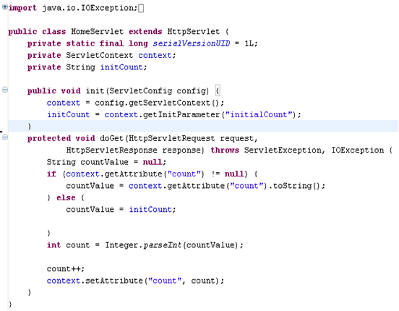
Step 1 : Creating HomeServlet
Create HomeServlet as illustrated below
Reads the context object. Note that the context object obtained from the config object using getServletContext() method. The context object is declared as class level member for further use.
Reads the context initial parameter
Reads the context attribute
Sets the context attribute

Slide 37
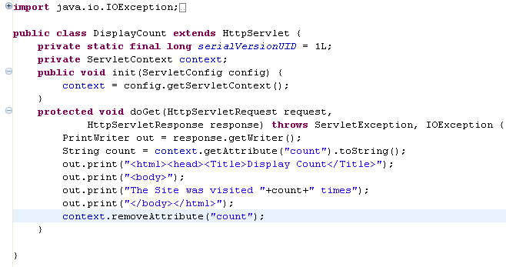
Step 2 : Create DisplayCount Servlet
Create a servlet named DisplayCount and add the following code to it.

Slide 38
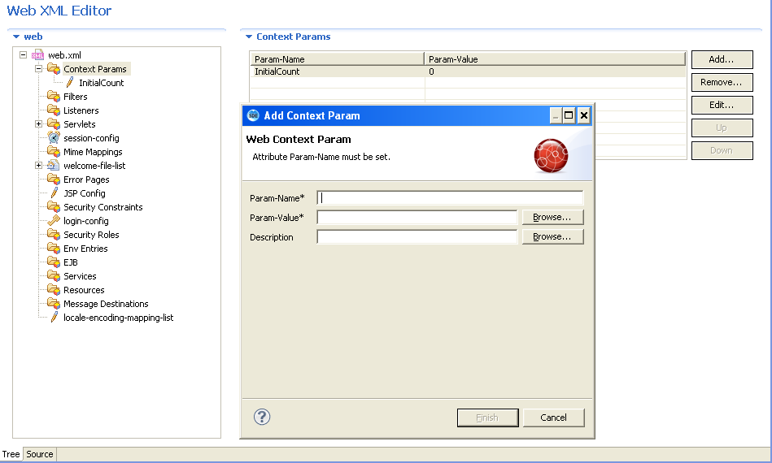
Step 3 : Setting Context init parameter
Open web.xml file in Tree mode
Click Context-params→Add
Enter the parameter name and value in the pop up window and click finish.
Enter Param-Name as “initialCount”
Enter Param-value as 0
Select Tree Option here

Slide 39
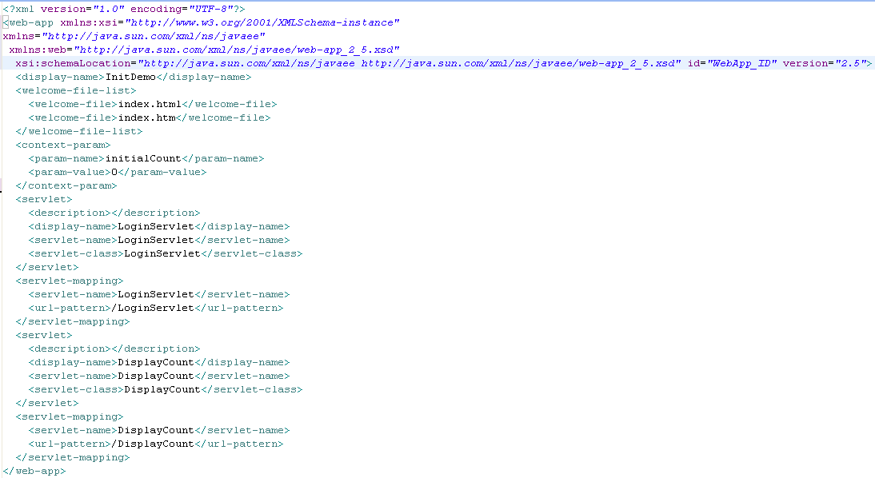
Verify The Web.xml Source
View the web.xml source by selecting the source view
Note the entry of Context-parameter in the xml

Slide 40

Step 4 : Deploy and Run the Application
Step 1 : Deploy the application
Step 2 : Access HomeServlet in browser using the URL,
http://localhost:8005/InitDemo/HomeServlet
HomeServlet will not print anything on the screen.
Step 3 : Refresh the Home servlet URL 5 times
Step 4 : Access DisplayCount Servlet in browser using the URL,
http://localhost:8005/InitDemo/DisplayCount
You will get the message as shown below

Slide 41
SERVLETS
You have successfully completed -
Servlet Config and Context

